Slide 1

Course Name - Object Oriented Programming using Java
Lecture 18– Command line arguments, Basics of I/O operations
Presented By
Dr. Sudipta Sahana
Asso. Prof.
Dept. of CSE
UEM – Kolkata

Slide 2
Topic of Interest
Command-Line Arguments
IO Stream
Byte Stream Classes
Character Stream Classes
Reading Characters
Reading Strings
Program to take String input from Keyboard in Java
Program to read from a file using Buffered Reader class
Java Scanner class
Scanner Example to get input from console

Slide 3
Command-Line Arguments
Sometimes you will want to pass some information into a program when you run it. This is accomplished by passing command-line arguments to main( ).
public class CommandLine {
public static void main(String args[]) {
for(int i = 0; i<args.length; i++) {
System.out.println("args[" + i + "]: " + args[i]);
}
}
}
Try executing this program as shown here –
java CommandLine this is a command line 200 -100
Output
args[0]: this
args[1]: is
args[2]: a
args[3]: command
args[4]: line
args[5]: 200
args[6]: -100

Slide 4
IO Stream
Java performs I/O through Streams. A Stream is linked to a physical layer by java I/O system to make input and output operation in java. In general, a stream means continuous flow of data. Streams are clean way to deal with input/output without having every part of your code understand the physical.
Java encapsulates Stream under java.io package. Java defines two types of streams. They are,
Byte Stream: It provides a convenient means for handling input and output of byte.
2. Character Stream: It provides a convenient means for handling input and output of characters. Character stream uses Unicode and therefore can be internationalized.
.

Slide 5
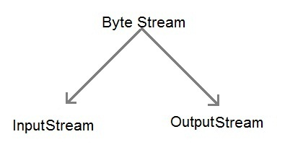
Byte Stream Classes
Byte stream is defined by using two abstract classes at the top of hierarchy, they are InputStream and OutputStream.
These two abstract classes have several concrete classes that handle various devices such as disk files, network connection etc.
.

Slide 6
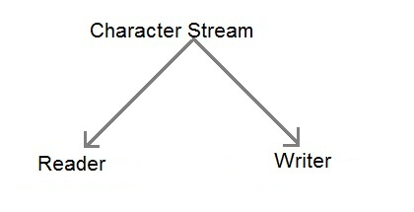
Character Stream Classes
Character stream is also defined by using two abstract classes at the top of hierarchy, they are Reader and Writer.
These two abstract classes have several concrete classes that handle unicode character.

Slide 7
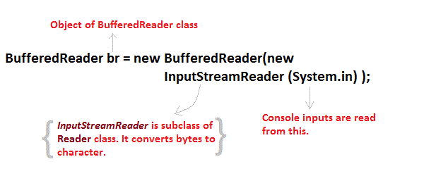
Some important Character stream classes
Stream class | Description
BufferedReader | Handles buffered input stream.
BufferedWriter | Handles buffered output stream.
FileReader | Input stream that reads from file.
FileWriter | Output stream that writes to file.
InputStreamReader | Input stream that translate byte to character
OutputStreamReader | Output stream that translate character to byte.
PrintWriter | Output Stream that contain print() and println() method.
Reader | Abstract class that define character stream input
Writer | Abstract class that define character stream output
We use the object of BufferedReader class to take inputs from the keyboard.

Slide 8
Reading Characters
read() method is used with BufferedReader object to read characters. As this function returns integer type value, we need to use typecasting to convert it into char type.
Syntax
int read() throws IOException
Below is a simple example explaining character input –
class CharRead
{
public static void main( String args[])
{
BufferedReader br = new Bufferedreader(new InputstreamReader(System.in));
char c = (char)br.read(); //Reading character
}
}

Slide 9
Reading Strings
To read string we have to use readLine() function with BufferedReader class's object.
Syntax
String readLine() throws IOException

Slide 10
Program to take String input from Keyboard in Java
import java.io.*;
class MyInput
{
public static void main(String[] args)
{
String text;
InputStreamReader isr = new InputStreamReader(System.in);
BufferedReader br = new BufferedReader(isr);
text = br.readLine(); //Reading String
System.out.println(text);
}
}

Slide 11
Program to read from a file using Buffered Reader class
import java. io *;
class ReadTest
{
public static void main(String[] args)
{
try
{
File fl = new File("d:/myfile.txt");
BufferedReader br = new BufferedReader(new FileReader(fl)) ;
String str;
while ((str=br.readLine())!=null)
{
System.out.println(str);
}
br.close();
fl.close();
}
catch (IOException e)
{ e.printStackTrace(); }
}
}

Slide 12
Java Scanner class
There are various ways to read input from the keyboard, the java.util.Scanner class is one of them.
The Java Scanner class breaks the input into tokens using a delimiter that is whitespace bydefault. It provides many methods to read and parse various primitive values.
Java Scanner class is widely used to parse text for string and primitive types using regular expression.
Java Scanner class extends Object class and implements Iterator and Closeable interfaces.

Slide 13
Scanner Example to get input from console
import java.util.Scanner;
class ScannerTest{
public static void main(String args[]){
Scanner sc=new Scanner(System.in);
System.out.println("Enter your rollno");
int rollno=sc.nextInt();
System.out.println("Enter your name");
String name=sc.next();
System.out.println("Enter your fee");
double fee=sc.nextDouble();
System.out.println("Rollno:"+rollno+" name:"+name+" fee:"+fee);
sc.close();
}
}
Output
Enter your rollno
111
Enter your name
Ratan
Enter your fee
450000
Rollno:111 name:Ratan fee:450000

Slide 14
Thank You

